Slide 1
CHAPTER FOUR JAVA NETWORKING
By: Behayilu M.
Faculty of Computing and software Eng.(FCSE),
Arba Minch Institute of Technology(AMiT),
Arba Minch University

Slide 2
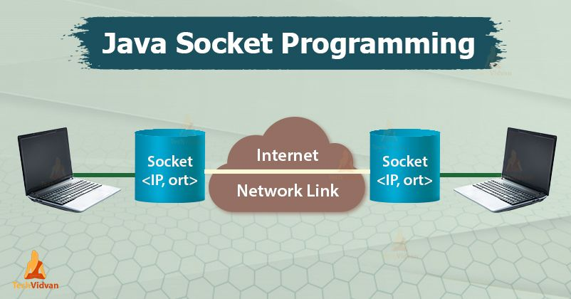
Objectives
To understand network programming
To understand URL processing
To communicate two programs using Socket programming

Slide 3
Networking Basics
Computer networking is to send and receive messages among computers on the Internet.
Java Networking is a concept of connecting two or more computing devices together so that we can share resources.
Network programming refers to writing programs that execute across multiple devices (computers), in which the devices are all connected to each other using a network.
When a computer needs to communicate with another computer, it needs to know an IP address.

Slide 4
Networking Basics
Internet Protocol (IP) addresses
Uniquely identifies the computer on the Internet. or
IP address is a unique number assigned to a node of a network.
It is a logical address that can be changed.
Every host on Internet has a unique IP address
An IP address consists of four dotted decimal numbers ranging from 0 and 255, such as
143.89.40.46, 203.184.197.198
203.184.197.196, 203.184.197.197, 127.0.0.1
Since it is difficult to remember IP address, there is a special server called Domain Name Server(DNS), which translates hostname to IP address
Example: DomainName: www.amu.edu.et , www.google.com, localhost
IP Addresess: 10.144.5.175 216.58.207.4 127.0.0.1
One domain name can correspond to multiple internet addresses:
www.yahoo.com:
66.218.70.49; 66.218.70.50; 66.218.71.80; 66.218.71.84; …
Domain Name Server (DNS) maps names to numbers
4

Slide 5
Networking Basics
A protocols is a set of rules that facilitate communications between machines or hosts.
Examples:
HTTP: HyperText Transfer Protocol
FTP: File Transfer Protocol
SMTP: Simple Message Transfer Protocol
TCP: Transmission Control Protocol
UDP: User Datagram Protocol, good for, e.g., video delivery)
TCP:
Connection-oriented protocol
enables two hosts to establish a connection and exchange streams of data.
Acknowledgement is send by the receiver. So, it is reliable but slow
Uses Stream-based communications
guarantees delivery of data and also guarantees that packets will be delivered in the same order in which they were sent.
UDP:
Enables connectionless communication
Acknowledgement is not sent by the receiver. So it is not reliable but fast.
Uses packet-based communications.
Cannot guarantee lossless transmission.
5

Slide 6
Networking Basics
Port Number
The port number is used to uniquely identify different applications.
It acts as a communication endpoint between applications.
The port number is associated with the IP address for communication between two applications.
Port numbers are ranging from 0 to 65536, but port numbers 0 to 1024 are
reserved for privileged services.
Many standard port numbers are pre-assigned
time of day 13, ftp 21, telnet 23, smtp 25, http 80
You can choose any port number that is not currently used by other programs.
IP address + port number = "phone number " for service or application
6

Slide 7
Networking Basics
Java offers
Stream-based communications that enable applications to view networking as streams of data as if it were file I/O. (TCP)
Packet-based communications for transmitting individual packets of information—commonly used to transmit data images, audio and video over the Internet. (UDP)

Slide 8
URL Processing
URL stands for Uniform Resource Locator and represents a resource on the World Wide Web, such as a Web page or FTP directory.
A URL can be broken down into parts, as
follows: protocol://host:port/path?query#ref
Examples of protocols include HTTP, HTTPS, FTP, and File.
Host is also called the authority.
It is the hostname or the IP address of the host to use.
Port is an optional parameter. If a port is not specified, the default port for the protocol is used. With HTTP, the default port is 80.
The path is also referred to as the filename,.
E.g: http://www.amrood.com/index.htm?language=en#j2se

Slide 9
URL class methods
The java.net.URL class represents a URL and has complete set of methods to manipulate URL in Java.
The URL class has several constructors for creating URLs, including the following:
public URL(String protocol, String host, int port, String file) throws MalformedURLException | Creates a URL by putting together the given parts.
public URL(String protocol, String host,String file) throws MalformedURLException | Identical to the previous constructor, except that the default port for the given protocol is used.
public URL(String url) throws MalformedURLException | Creates a URL from the given String
public URL(URL context, String url) throws MalformedURLException | Creates a URL by parsing the together the URL and String arguments

Slide 10
…cont’d
The URL class contains many methods for accessing the various parts of the URL being represented. Some of the methods in the URL class include the following:
public String getPath() | Returns the path of the URL
public String getQuery() | Returns the query part of the URL.
public String getAuthority() | Returns the authority of the URL
public int getPort() | Returns the port of the URL
public int getDefaultPort() | Returns the default port for the protocol of the URL.
public String getProtocol() | Returns the protocol of the URL.
public String getHost() | Returns the host of the URL.
public String getFile() | Returns the filename of the URL.
public String getRef() | Returns the reference part of the URL
public URLConnection openConnection() throws IOException | Opens a connection to the URL, allowing a client to communicate with the resource

Slide 11
…cont’d
import java.net.*;
import java.io.*;
public class URLTest{
public static void main(String args[])
{
try{
URL url=new URL("http://www.amrood.com/index.htm ?language=en#j2se");
System.out.println("URL is "+ url.toString());
System.out.println("protocol is "+ url.getProtocol());
System.out.println("authority is "+ url.getAuthority());
System.out.println("file name is "+ url.getFile());
System.out.println("host is "+ url.getHost());
System.out.println("path is "+ url.getPath());
System.out.println("port is "+ url.getPort());
System.out.println("default port is "+ url.getDefaultPort());
System.out.println("query is "+ url.getQuery());
System.out.println("ref is "+ url.getRef());
}catch(IOException e){e.printStackTrace();
}}
}
URL is http://www.amrood.com/index.htm?language=en#j2se
protocol is http
authority is www.amrood.com
file name is /index.htm?language=en
host is www.amrood.com
path is /index.htm
port is -1
default port is 80
query is language=en
ref is j2se

Slide 12
URLConnection class
URLConnection is a general-purpose class for accessing the attributes of a remote resource.
Once we make a connection to a remote server, we can use URLConnection to inspect the properties of the remote object before actually transporting it locally.
URLConnection is created using the openConnection( ) method of a URL object and can then use it to examine the document’s properties and content.
The openConnection() method returns a java.net.URLConnection, an abstract class whose subclasses represent the various types of URL connections.
For example: If you connect to a URL whose protocol is HTTP, the openConnection() method returns an HttpURLConnection object.
If you connect to a URL that represents a JAR file, the openConnection() method returns a JarURLConnection object. etc...

Slide 13
…cont’d
The URLConnection class has many methods for setting or determining information about the connection, including the following:
Object getContent() | Retrieves the contents of this URL connection.
int getContentLength() | Returns the value of the content-length header field.
String getContentType() | Returns the value of the content-type header field
public InputStream getInputStream() throws IOException | Returns the input stream of the URL connection for reading from the resource.
public OutputStream getOutputStream() throws IOException | Returns the output stream of the URL connection for writing to the resource
public URL getURL() | Returns the URL that this URLConnection object is connected to

Slide 14
…cont’d
import java.io.*;
public class URLConnectionReader
{
public static void main(String[] args) throws Exception
{
URL ur = new URL("http://www.amu.edu.et");
URLConnection uc = ur.openConnection();
System.out.println("Content Type: " + uc.getContentType());
BufferedReader in = new BufferedReader(new InputStreamReader(uc.getInputStream()));
String inputLine;
while ((inputLine = in.readLine()) != null)
System.out.println(inputLine);
in.close();
}
}

Slide 15
The InetAdress class
Handles Internet addresses both as host names and as IP addresses.
Static method getByName of this class uses DNS (Domain Name System) to return the Internet address of a specified host name as an InetAddress object.
In order to display the IP address from this object, we can simply use method println(). (which will cause the object's toString() method to be executed).
Since method getByName() throws the checked exception UnknownHostException if the host name is not recognised, we must either throw this exception or (preferably) handle it with a catch clause.

Slide 16
…cont’d
import java.net.*;
import java.util.*;
public class IPFinder{
public static void main(String[] args){
String host;
Scanner input = new Scanner(System.in); //For input from keyboard
System.out.println("Enter host name: ");
host = input.next();
try{
InetAddress address = InetAddress.getByName(host);
System.out.println("IP address: "+ address.toString());
} catch (UnknownHostException uhEx)
{
System.out.println("Could not find " + host);
}
}}
Enter host name: www.amu.edu.et
IP address: www.amu.edu.et/10.144.5.175

Slide 17
Socket programming
Java Socket programming is used for communication between the applications running on different JRE.
Java Socket programming can be connection-oriented or connection-less.
Socket and ServerSocket classes are used for connection-oriented socket programming.
DatagramSocket and DatagramPacket classes are used for connection-less socket programming.
Java socket programming provides facility to share data between different computing devices.
Send and receive data using streams
OutputStream
InputStream
Server
Client
InputStream
OutputStream
7

Slide 18
Socket programming
Socket is an abstraction that is provided to an application programmer to send or receive data to another process.
Data can be sent to or received from another process running on the same machine or a different machine.
Exists on either side of connection.
Identified by IP Address and Port number (Socket Address).
A socket is an abstract concept and not an element of computer hardware.
It is used to indicate one of the two end-points of a communication link between two processes.

Slide 19
TCP/IP Socket programming
Java provides the ServerSocket class for creating a server socket and the Socket class for creating a client socket.
Two programs on the Internet communicate through a server socket and a client socket using I/O streams.
Sockets are the endpoints of logical connections between two hosts and can be used to send and receive data.
Network programming usually involves a server and one or more clients.
The client sends requests to the server, and the server responds.
The client begins by attempting to establish a connection to the server.
The server can accept or deny the connection.
Once a connection is established, the client and the server communicate through sockets.
The server must be running when a client attempts to connect to the server.
The server waits for a connection request from a client.
8

Slide 20
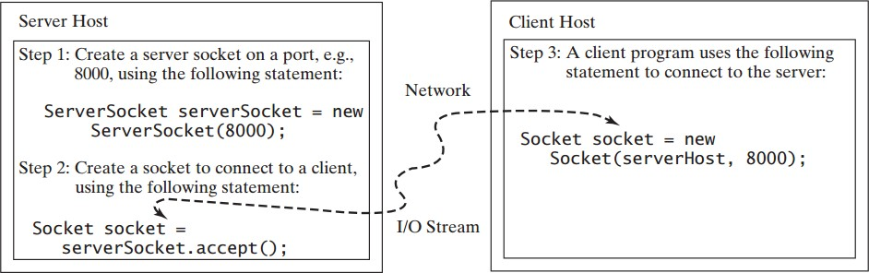
TCP/IP Socket programming
The statements needed to create sockets on a server and a client are shown below.

Slide 21
Server Sockets
To establish a server, you need to create a server socket and attach it to a port, which is where the server listens for connections.
The port identifies the TCP service on the socket.
The following statement creates a server socket serverSocket:
ServerSocket serverSocket = new ServerSocket(port);
Attempting to create a server socket on a port already in use would cause the java.net.BindException.

Slide 22
Client Sockets
After a server socket is created, the server can use the following statement to listen for connections:
Socket socket = serverSocket.accept();
This statement waits until a client connects to the server socket.
The client issues the following statement to request a connection to a server:
Socket socket = new Socket(serverName, port);
This statement opens a socket so that the client program can communicate with the server.

Slide 23
Client Sockets
serverName is the server’s Internet host name or IP address.
The following statement creates a socket on the client machine to connect to the host 130.254.204.33 at port 8000:
Socket socket = new Socket("130.254.204.33", 8000)
Alternatively, you can use the domain name to create a socket, as follows:
Socket socket = new Socket("www.google.com", 8000);
When you create a socket with a host name, the JVM asks the DNS to translate the host name into the IP address.

Slide 24
Data Transmission through Sockets
After the server accepts the connection, communication between the server and client is conducted the same as for I/O streams.
The statements needed to create the streams and to exchange data between them are shown in the Figure below.

Slide 25
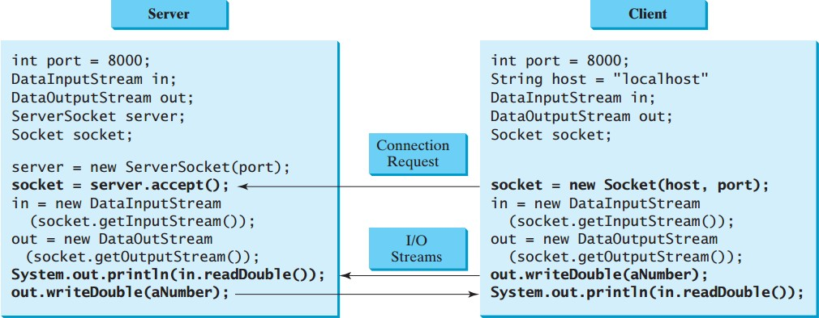
Data Transmission through Sockets

Slide 26
Data Transmission through Sockets
To get an input stream and an output stream, use the getInputStream() and getOutputStream() methods on a socket object.
For example, the following statements create an InputStream stream called input and an OutputStream stream called output from a socket:
InputStream input = socket.getInputStream();
OutputStream output = socket.getOutputStream();
DataInputStream in = new DataInputStream(input);
DataOutputStream out = new DataOutputStream(output));

Slide 27
Data Transmission through Sockets
The InputStream and OutputStream streams are used to read or write bytes.
You can use DataInputStream, DataOutputStream and BufferedReader to wrap on the InputStream and OutputStream to read or write data, such as int, double, or String.
The following statements, for instance, create the DataInputStream stream input and the DataOutputStream stream output to read and write primitive data values:
DataInputStream input = new DataInputStream (socket.getInputStream());
DataOutputStream output = new DataOutputStream (socket.getOutputStream());
The server can use input.readDouble() to receive a double value from the client, and output.writeDouble(d) to send the double value d to the client.
Binary I/O is more efficient than text I/O because text I/O requires encoding and decoding.
Therefore, it is better to use binary I/O for transmitting data between a server and a client to improve performance.

Slide 28
Example…one way communication
import java.net.*;
import java.io.*;
public class SimpleServer{
public static void main(String args[]) throws IOException
{
ServerSocket ss=new ServerSocket(2223);
Socket s=ss.accept();
OutputStream sout=s.getOutputStream();
DataOutputStream dos=new DataOutputStream(sout);
dos.writeUTF("Hi I am Server");
dos.close();
sout.close();
s.close();
}
}

Slide 29
Example…one way communication
import java.net.*;
import java.io.*;
public class SimpleClient{
public static void main(String args[]) throws IOException
{
Socket s=new Socket("localhost",2223);
InputStream sin=s.getInputStream();
DataInputStream dis=new DataInputStream(sin);
String str=new String(dis.readUTF());
System.out.println(str);
dis.close();
sin.close();
s.close();
}
}

Slide 30
Exercise
Problem: Write a client and a server program that the client sends data to a server. The server receives the data, uses it to produce a result, and then sends the result back to the client. The client displays the result on the console. In this example, the data sent from the client is the radius of a circle, and the result produced by the server is the area of the circle. The client sends the radius to the server; the server computes the area and sends it to the client.
compute area
radius
Server
Client
area

Slide 31
UDP Socket Programming
Datagram packets are used to implement a connectionless packet delivery service supported by the UDP protocol.
Each message is transferred from source machine to destination based on information contained within that packet.
That means, each packet might be routed differently, and might arrive in any order.
Packet delivery is not guaranteed.
Java supports datagram communication through the following classes:
DatagramPacket
DatagramSocket

Slide 32
UDP Socket Programming
A datagram socket is the sending or receiving point for a packet delivery service.
Each packet sent or received on a datagram socket is individually addressed and routed.
Datagram packets are used to implement a connectionless packet delivery service.
Each message is routed from one machine to based solely on information contained within that packet.

Slide 33
UDP Socket Programming
The class DatagramSocket contains several constructors that can be used for creating socket.
Some of them is:
DatagramSocket( ) - Constructs a datagram socket and binds it to any available port on the local host machine
DatagramSocket(int port) - Constructs a datagram socket and binds it to the specified port on the local host machine.

Slide 34
UDP Socket Programming
The class DatagramPacket contains several constructors that can be used for creating packet object.
One of them is:
DatagramPacket(byte[] buf, int length, InetAddress address, int port);
This constructor is used for creating a datagram packet for sending packets of length ‘length’ to the specified port number on the specified host.
The message to be transmitted is indicated in the first argument.

Slide 35
UDP Socket Programming
The key methods of DatagramPacket class are:
byte[] getData() | Returns the data buffer
int getLength() | Returns the length of the data to be sent or the length of the data received
void setData(byte[] buf) | Sets the data buffer for this packet.
void setLength(int length) | Sets the length for this packet.

Slide 36
UDP Socket Programming
The class DatagramSocket supports various methods that can be used for transmitting or receiving a datagram over the network.
The two key methods are:
void send(DatagramPacket p) | Sends a datagram packet from this socket.
void receive(DatagramPacket p) | Receives a datagram packet from this socket.

Slide 37
Example…two way communication
import java.net.*;
import java.io.*;
public class SimpleServerUDP{
public static void main(String args[]) throws IOException
{
DatagramSocket serversocket=new DatagramSocket(9223);
byte[] rd = new byte[1024];
byte[] sd = new byte[1024];
DatagramPacket dpr=new DatagramPacket(rd, rd.length);
serversocket.receive(dpr);
System.out.println("Data from Client : "+ new String(dpr.getData()));
System.out.println("Enter your message to send:");
BufferedReader FromServer = new BufferedReader(new InputStreamReader(System.in));
String sentence = FromServer.readLine();
sd=sentence.getBytes();
DatagramPacket dps=new DatagramPacket(sd,sd.length,dpr.getAddress(),dpr.getPort());
serversocket.send(dps);
serversocket.close();
}
}
Receive data
Send data

Slide 38
Example…two way communication
import java.net.*;
import java.io.*;
public class SimpleClientUDP{
public static void main(String args[]) throws IOException
{
DatagramSocket clientSocket = new DatagramSocket();
String s="Hi";
byte[] senddata =s.getBytes();
InetAddress IPAddress = InetAddress.getByName("localhost");
DatagramPacket dps = new DatagramPacket(senddata,senddata.length,IPAddress,9223);
clientSocket.send(dps);
System.out.println("Data send to server");
byte[] buffer =new byte[1024];
DatagramPacket reply = new DatagramPacket(buffer, buffer.length);
clientSocket.receive(reply);
System.out.println("Data from Server: "+new String(buffer));
clientSocket.close();
}
}
Send data
Receive data

Slide 39
≈ ∕∕ ≈

